Slide 1
Deep Learning

Slide 2
Introduction
Deep learning (DL) is a subset of machine learning and artificial intelligence (AI) that is concerned with algorithms inspired by the structure and function of the brain called artificial neural networks.
Major concepts in DL:
Artificial Neural Networks (ANNs)
DL layers
Training DL models
Activation Function
Deep Networks in DL
Type of Deep Learning Models

Slide 3
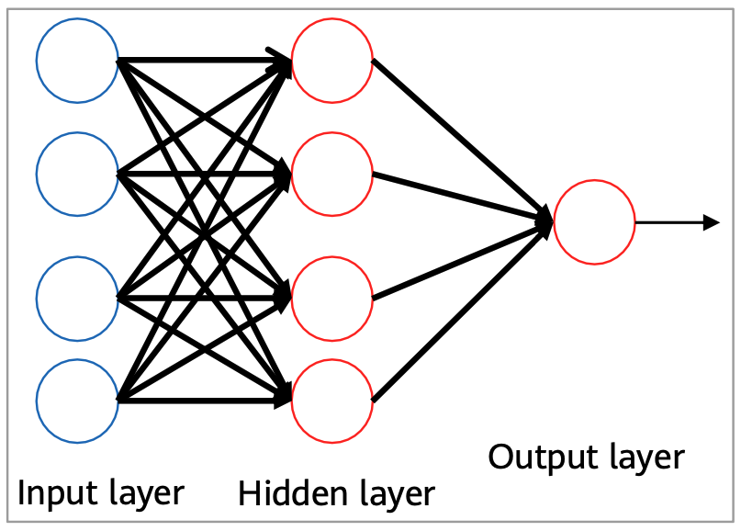
Artificial Neural Networks
Computational models inspired by the human brain:
Massively parallel, distributed system, made up of simple processing units (neurons).
Synaptic connection strengths among neurons are used to store the acquired knowledge.
Knowledge is acquired by the network from its environment through a learning process.

Slide 4
Properties of ANNs
Learning from examples: labeled or unlabeled
Adaptivity: changing the connection strengths to learn things
Non-linearity: the non-linear activation functions are essential
Fault tolerance: if one of the neurons or connections is damaged, the whole network still works quite well.
Thus, they might be better alternatives than classical solutions for problems characterized by:
High dimensionality, noisy, imprecise or imperfect data;
a lack of a clearly stated mathematical solution or algorithm.

Slide 5
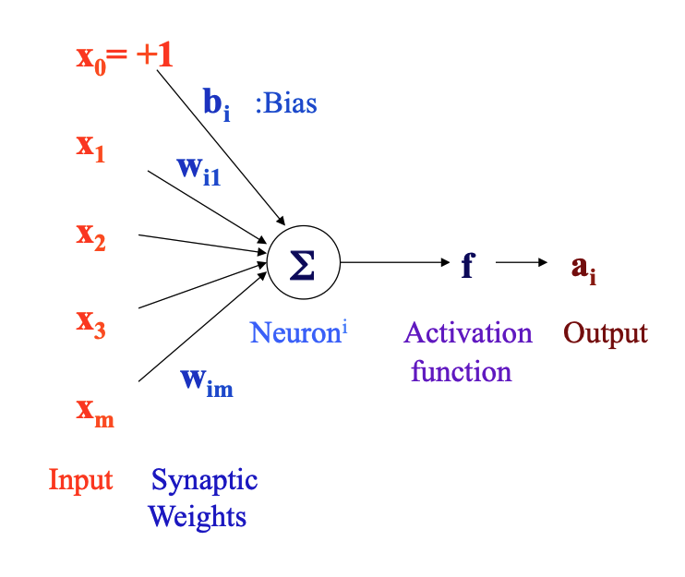
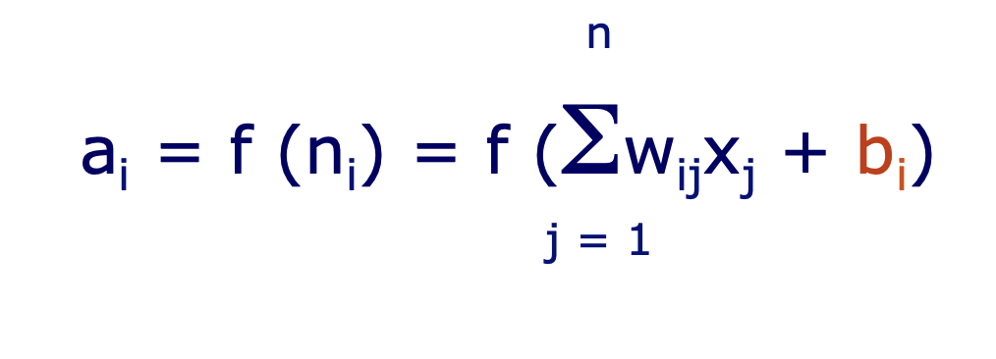
Artificial Neuron Model
An artificial neuron:
computes the weighted sum of its input (called its net input)
adds its bias
passes this value through an activation function
We say that the neuron “fires” (i.e. becomes active) if its output is above zero.

Slide 6
Input
One principle of neural modeling is that the inputs are known, or they can be measured.
The behavior of outputs is investigated when input varies.
All information has to be converted into vector form.

Slide 7
Synaptic weights
Synaptic weights: are interneuron connection strengths, are used to store the learned information.

Slide 8
Bias
Bias can be incorporated as another weight clamped to a fixed input of +1.0
This extra free variable (bias) makes the neuron more powerful.

Slide 9
Activation functions
Activation functions: Also called the squashing function as it limits the amplitude of the output of the neuron.
Activation functions: is a function between outputs of nodes at the previous layer and inputs of nodes at the next layer.
Purpose of Activation Functions:
The complexity of linear functions is limited, and the capability of learning complex function mappings from data is low.
The activation function is equivalent to adding nonlinear factors to a neural network, which transforms the neural network into a nonlinear model.

Slide 10
Artificial Neural Networks
A neural network is a massively parallel, distributed processor made up of simple processing units (artificial neurons).
Its is a computing system made up of a number of simple, highly interconnected processing elements, which process information by their dynamic state response to external inputs.
It can be simply expressed as an information processing system designed to imitate the human brain structure and functions.
It resembles the brain in two respects:
Knowledge is acquired by the network from its environment through a learning process
Synaptic connection strengths among neurons are used to store the acquired knowledge.

Slide 11
Different ANN Topologies

Slide 12
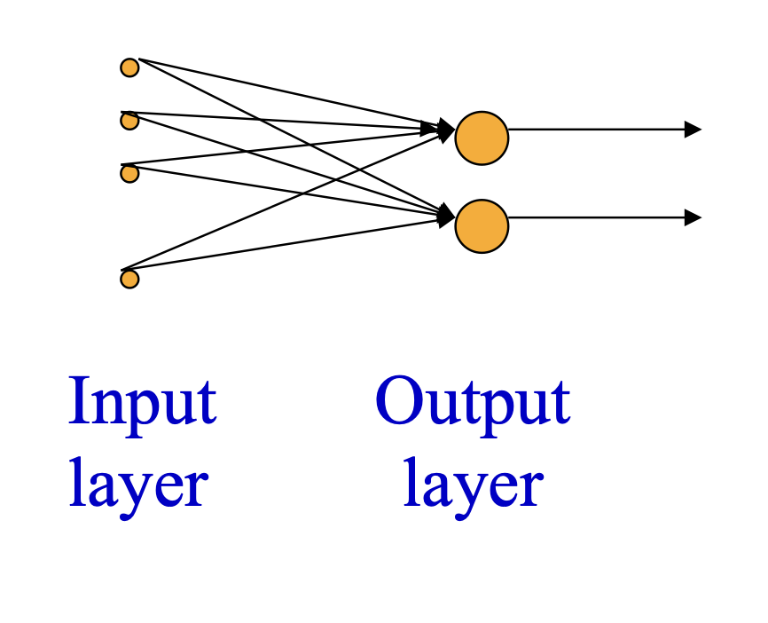
Single Layer Feed-Forward Networks
Input layer is directly projected into the output layer.
The simplest form of neural networks.
The input layer is not counted as a layer because no computation is performed there.

Slide 13
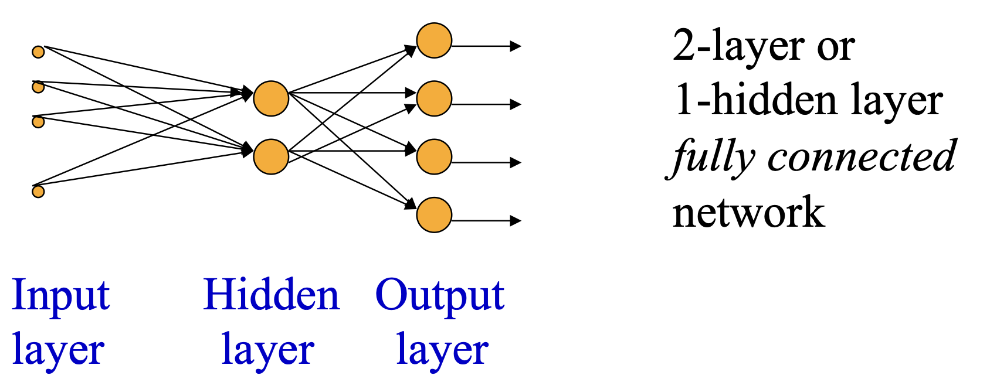
Multi-Layer Feed-Forward Networks
It has at least one or more hidden layers.
The hidden neurons can extract higher-order statistics and acquire more global information.
Typically, the input signals of a layer consist of the output signals of the preceding layer only.

Slide 14
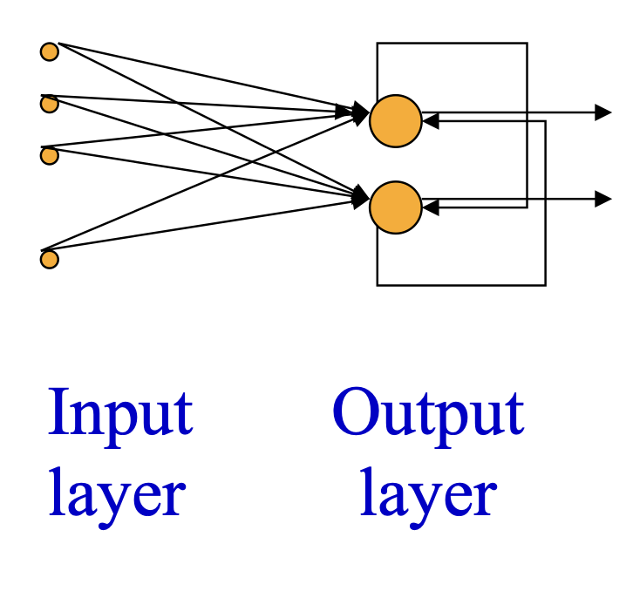
Recurrent Neural Networks
A network with feedback, where some of its inputs are connected to some of its outputs (discrete time).
In a feedforward network there are no feedback loops.

Slide 15
DEEP LEARNING LAYERS
Single Layer Perceptron (SLP) & Multi-Layer Perceptron (MLP)

Slide 16
Single Layer Perceptron (SLP)
A Single Layer Perceptron (SLP) is one of the simplest types of artificial neural networks. It serves as the foundational building block for more complex deep learning models.
Structure of a Single Layer Perceptron
Input Layer: The perceptron has one input layer where each neuron (also called a node) represents one feature from the input data. If you have nn features, you’ll have nn input neurons.
Output Layer: There’s a single output layer with one or more neurons, depending on the task. For binary classification, there is usually one output neuron; for multi-class classification, there are as many output neurons as there are classes.

Slide 17


Single Layer Perceptron (SLP)
SPL Parameters:
Weighted Sum: Each input xixi​ is associated with a weight wiwi​. The perceptron computes a weighted sum of the inputs:
where bb is the bias term, which allows the perceptron to shift the decision boundary away from the origin.
Activation Function: The weighted sum zz is then passed through an activation function ϕ(z)ϕ(z) to produce the output. In a basic perceptron, the activation function is typically a step function:
This results in a binary output, making the perceptron a linear classifier.

Slide 18
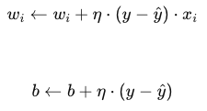
Single Layer Perceptron (SLP) – training process
Initialization: Start with random weights and bias.
Forward Pass: Compute the output using the current weights.
Error Calculation: Compare the perceptron’s output with the actual target value to calculate the error.
Weight Update (Learning Rule): Adjust the weights and bias to reduce the error. This is done using the Perceptron Learning Rule:
where η is the learning rate, y is the true label, and y^ is the predicted label.

Slide 19
Single Layer Perceptron (SLP) – Limitations
Linearly Separable Data: The perceptron can only solve problems where the data is linearly separable. This means that it can only find a linear decision boundary (a straight line in 2D space) to separate the classes.
No Non-Linearity: The step function is a simple threshold function, which limits the perceptron’s ability to model complex, non-linear relationships in the data.

Slide 20
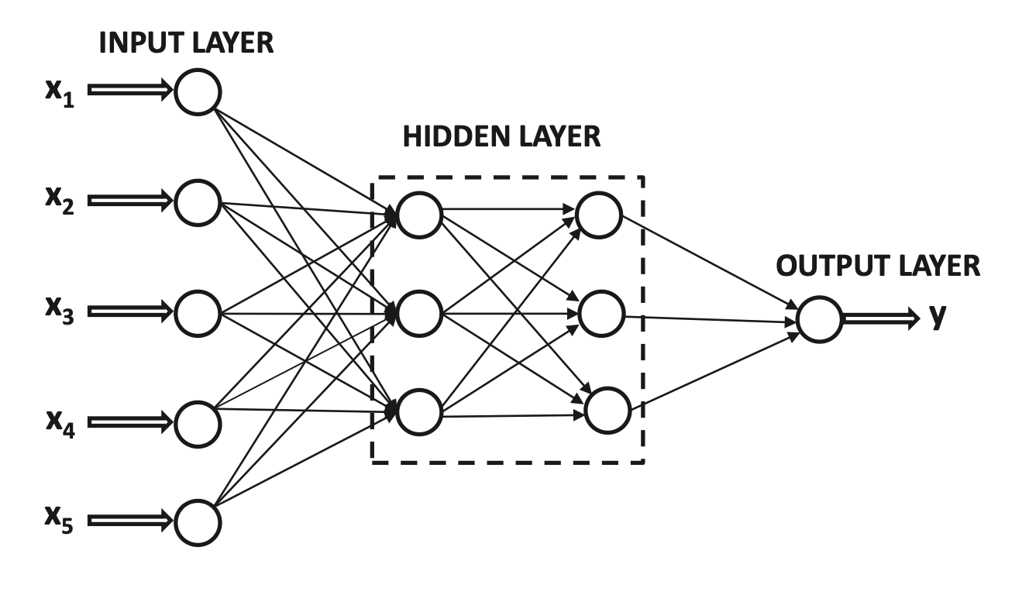
Multi-Layer Perceptron
In multilayer networks, the output of a node can feed into other hidden nodes, which in turn can feed into other hidden or output nodes.
Multilayer neural networks are always directed acyclic graphs and usually arranged in layer wise fashion.
Multilayer networks with non-linear activations ⇒ Good for data with a lot of structure.
Datasets that have complex relationships among their features. This complexity could be due to high dimensionality or non-linear relationships that simple models (like linear regressors or single-layer perceptron) cannot capture effectively.
Multilayer networks with non-linear activations excel in handling such data because they can learn from the complexity and structure of the data.

Slide 21
Architecture and Components of MLP
The layers between the input and output are referred to as hidden because they perform intermediate computations.
Each hidden node uses a combination of a linear transformation and an activation function Φ(·) (like the output node of the perceptron).
The use of nonlinear activation functions in the hidden layer is crucial in increasing learning capacity.

Slide 22
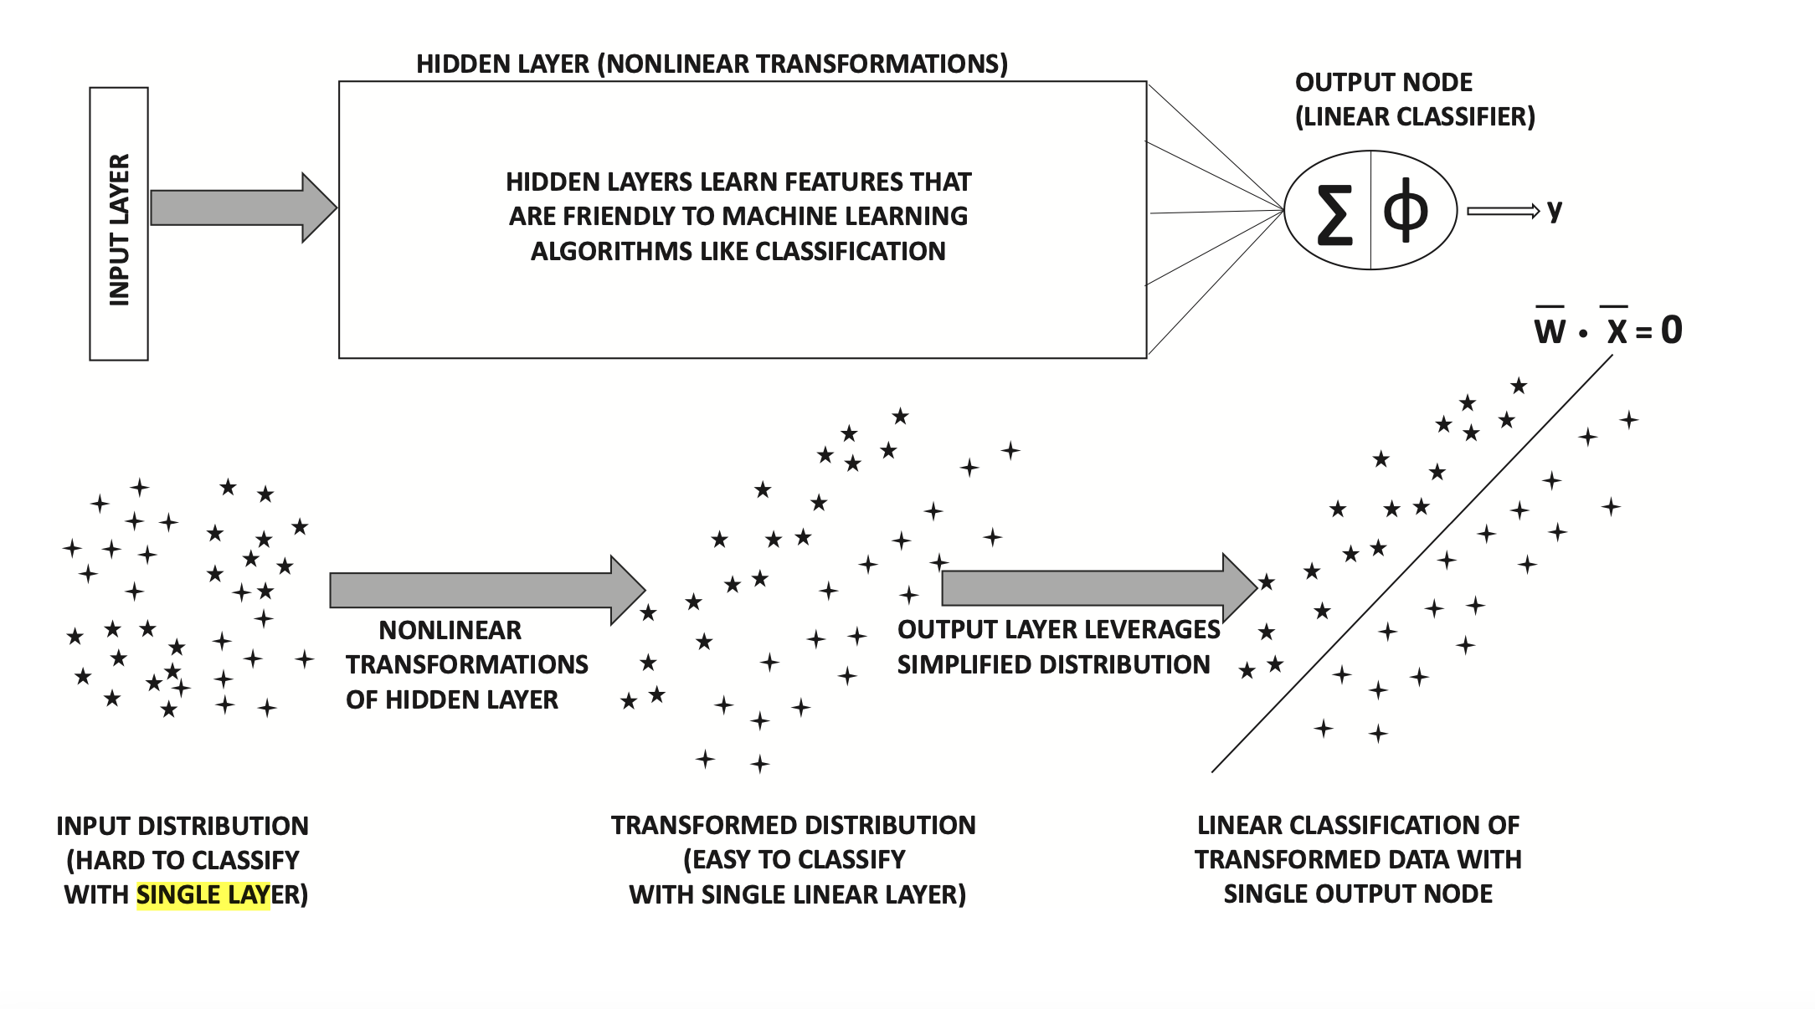
Role of Hidden Layers
Nonlinear hidden layers perform the role of hierarchical feature engineering.
Early layers learn primitive features and later layers learn more complex features.
Image data: Early layers learn elementary edges, the middle layers contain complex features like honeycombs, and later layers contain complex features like a part of a face.
The final output layer is often able to perform inference with transformed features in penultimate layer relatively easily.
Perceptron: Cannot classify linearly inseparable data but can do so with nonlinear hidden layers.

Slide 23
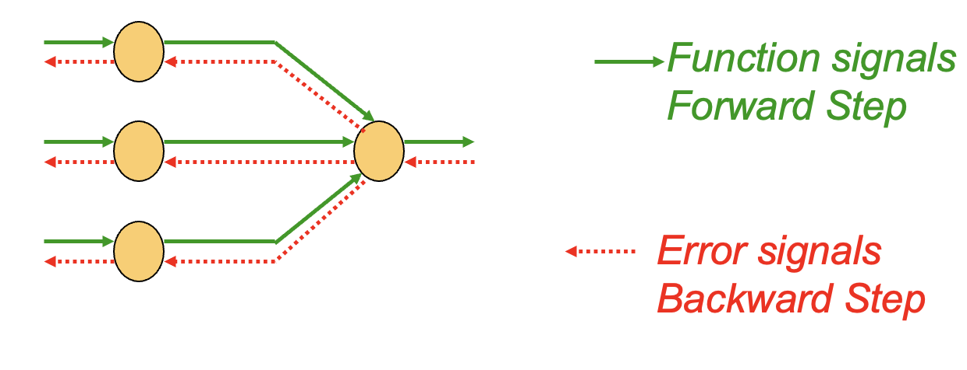
Learning Process
We want to compute the derivatives with respect to the parameters in all layers to perform gradient descent.
The complex nature of the composition function makes this difficult.
The key idea to achieve this goal is backpropagation. It adjusts the weights of the NN in order to minimize the average squared error.

Slide 24
Learning Process
Forward Pass: Input data is fed into the network, and its output is computed layer by layer. This phase uses the network's current parameters to calculate the predicted output for each input.
Loss Calculation: Once the network produces an output, the difference between this output and the true target values (known as the loss or error) is calculated using a loss function. Common loss functions include Mean Squared Error (MSE) for regression tasks and Cross-Entropy for classification tasks.
Backward Pass (Back-Propagation): The goal of back-propagation is to compute the gradient of the loss function with respect to each parameter (weight and bias) in the network. This involves applying the chain rule of calculus to propagate the error backward from the output layer through the hidden layers to the input layer.

Slide 25
Difference Between SLP and MLP
The key differences between Single Layer Perceptron (SLP) and Multi-Layer Perceptron (MLP):
Architecture:
SLP: Consists of a single layer of output nodes; the inputs are directly connected to the outputs without any hidden layers in between.
MLP: Contains one or more hidden layers in addition to the input and output layers. These hidden layers enable MLPs to model complex functions.
Complexity and Non-linearity:
LP: Can only model linear decision boundaries due to its lack of hidden layers. It's limited to solving linearly separable problems.
MLP: Can model complex, non-linear decision boundaries thanks to its multiple layers and non-linear activation functions, making it suitable for a wide range of complex tasks.
Activation Functions:
SLP: Often uses a simple step function or linear activation function.
MLP: Employs non-linear activation functions such as sigmoid, tanh, or ReLU (Rectified Linear Unit) in its hidden layers, which are key to its ability to learn complex patterns.

